Slide 1
Cell

Slide 2
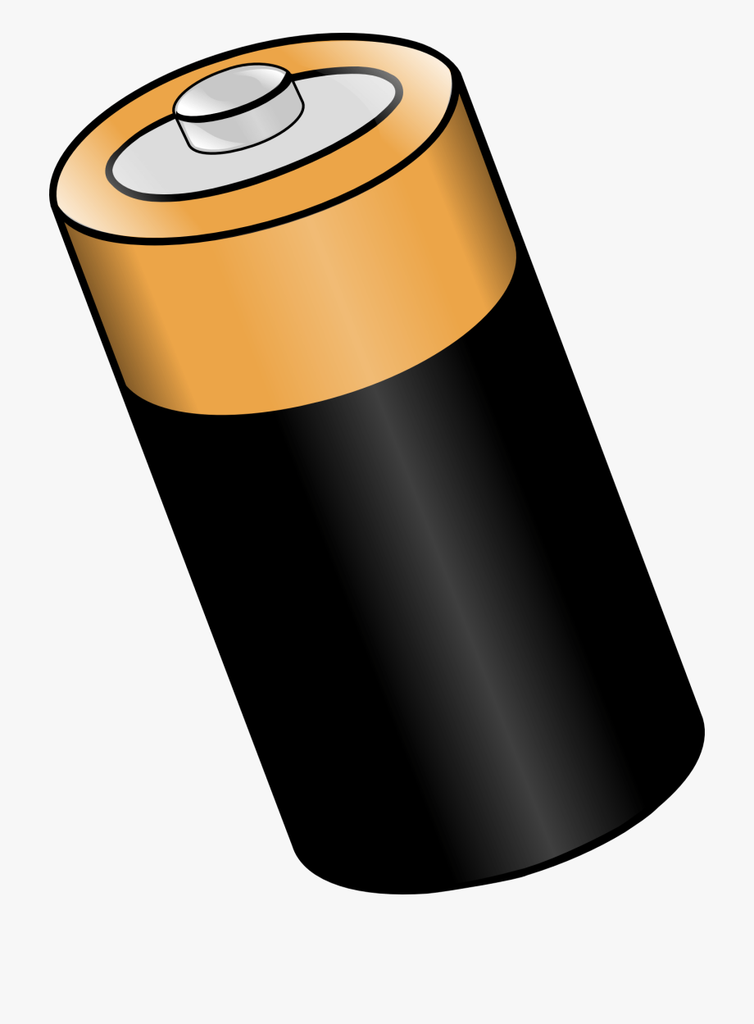
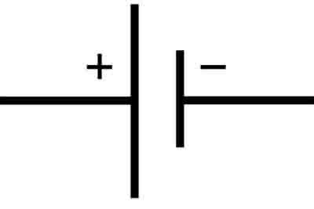
Cell
A single unit that converts chemical energy into electrical energy.

Slide 3
Battery

Slide 4
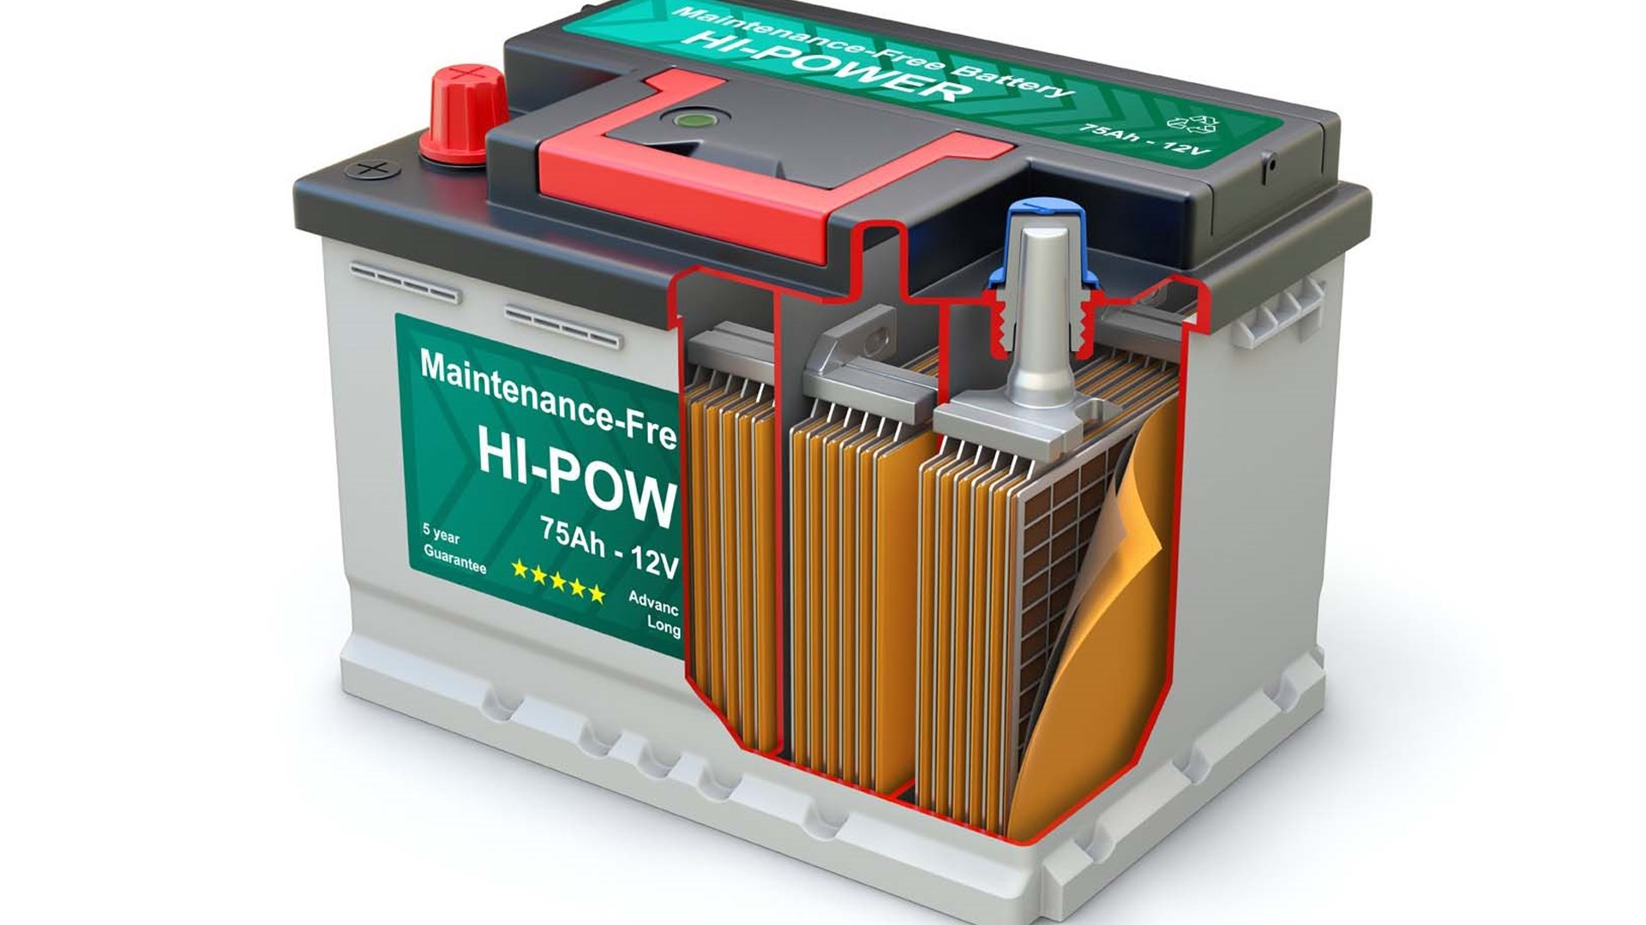
Battery
Two or more cells that convert chemical energy into electrical energy.

Slide 5
Circuit

Slide 6
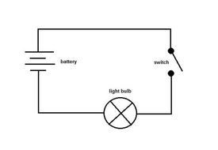
Circuit
A circuit is a complete path around which electricity can flow. It must include a source of electricity.

Slide 7
Component

Slide 8
Component
Each part that makes up the circuit.
e.g cell, motor, buzzer etc

Slide 9
Electric current

Slide 10
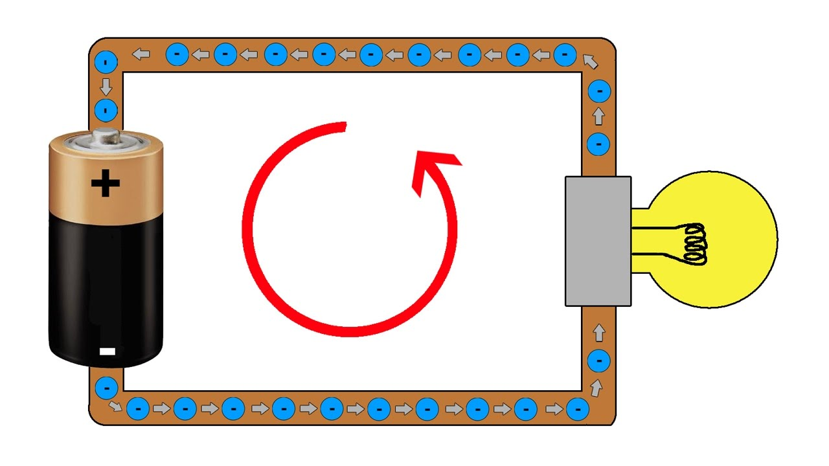
Electric current
The flow of electrons around a circuit

Slide 11
Electron

Slide 12
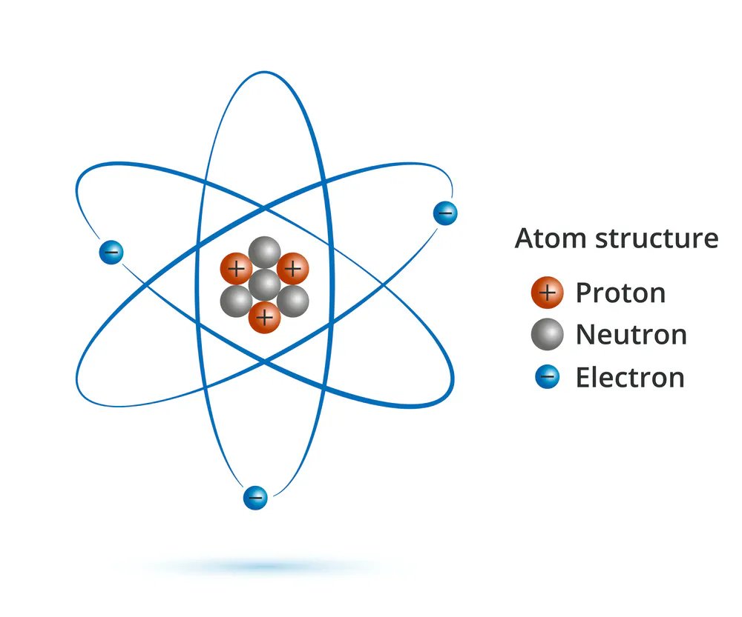
Electron
A small piece of matter and energy.

Slide 13
Negative Terminal

Slide 14
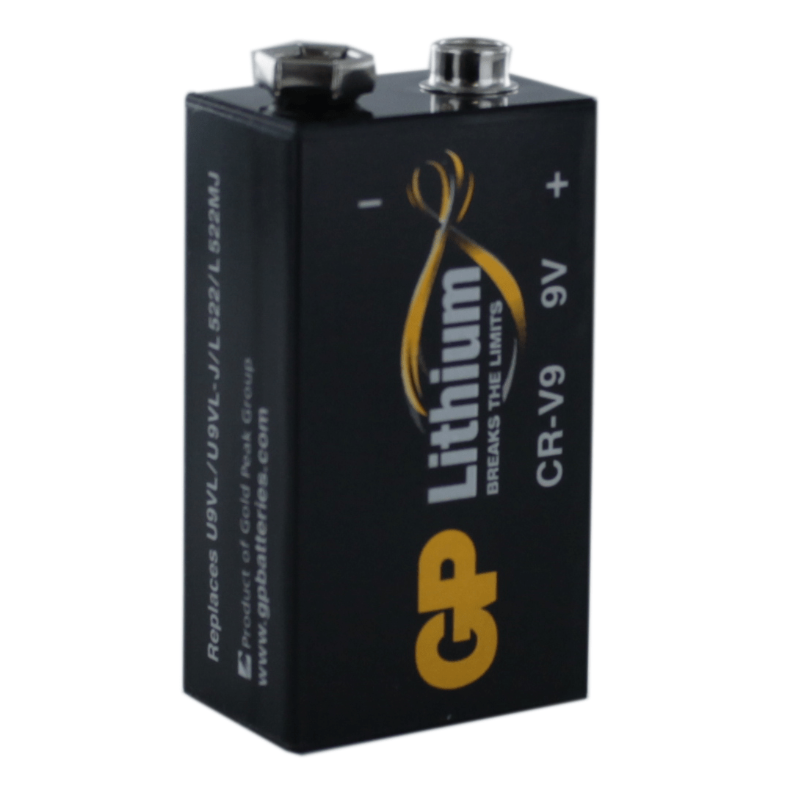
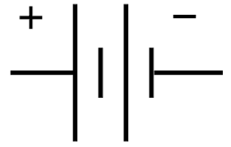
Negative Terminal
The terminal of a battery or other voltage source that has more electrons than normal. Electrons flow from the negative terminal through the circuit to the positive terminal.

Slide 15
Positive Terminal

Slide 16
Positive Terminal
The terminal of a battery or other voltage source which electrons flow towards through the circuit.

Slide 17
Series Circuit

Slide 18
Series Circuit
A single pathway that electrons can flow through.

Slide 19
Parallel Circuit

Slide 20
Parallel Circuit
A circuit with multiple pathways that electrons can flow through.

Slide 21
Resistance

Slide 22
Resistance
The measure of how much a component decreases the flow of electrons in a circuit.

Slide 23
Terminal

Slide 24
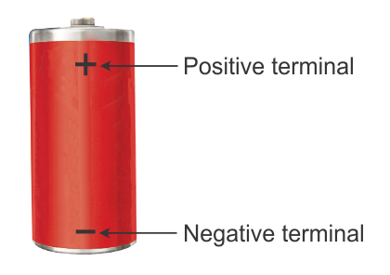
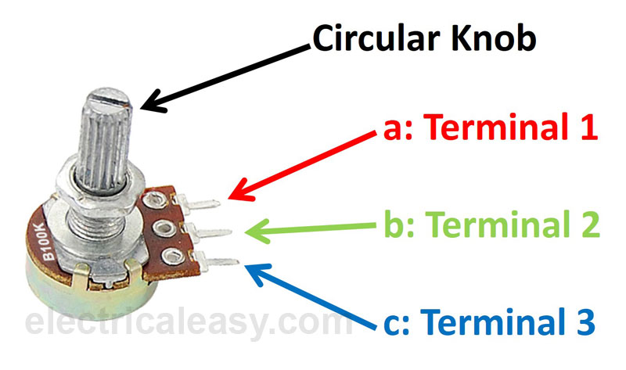
Terminal
The point at which a component’s conductor comes to an end.

Slide 25
Voltage

Slide 26
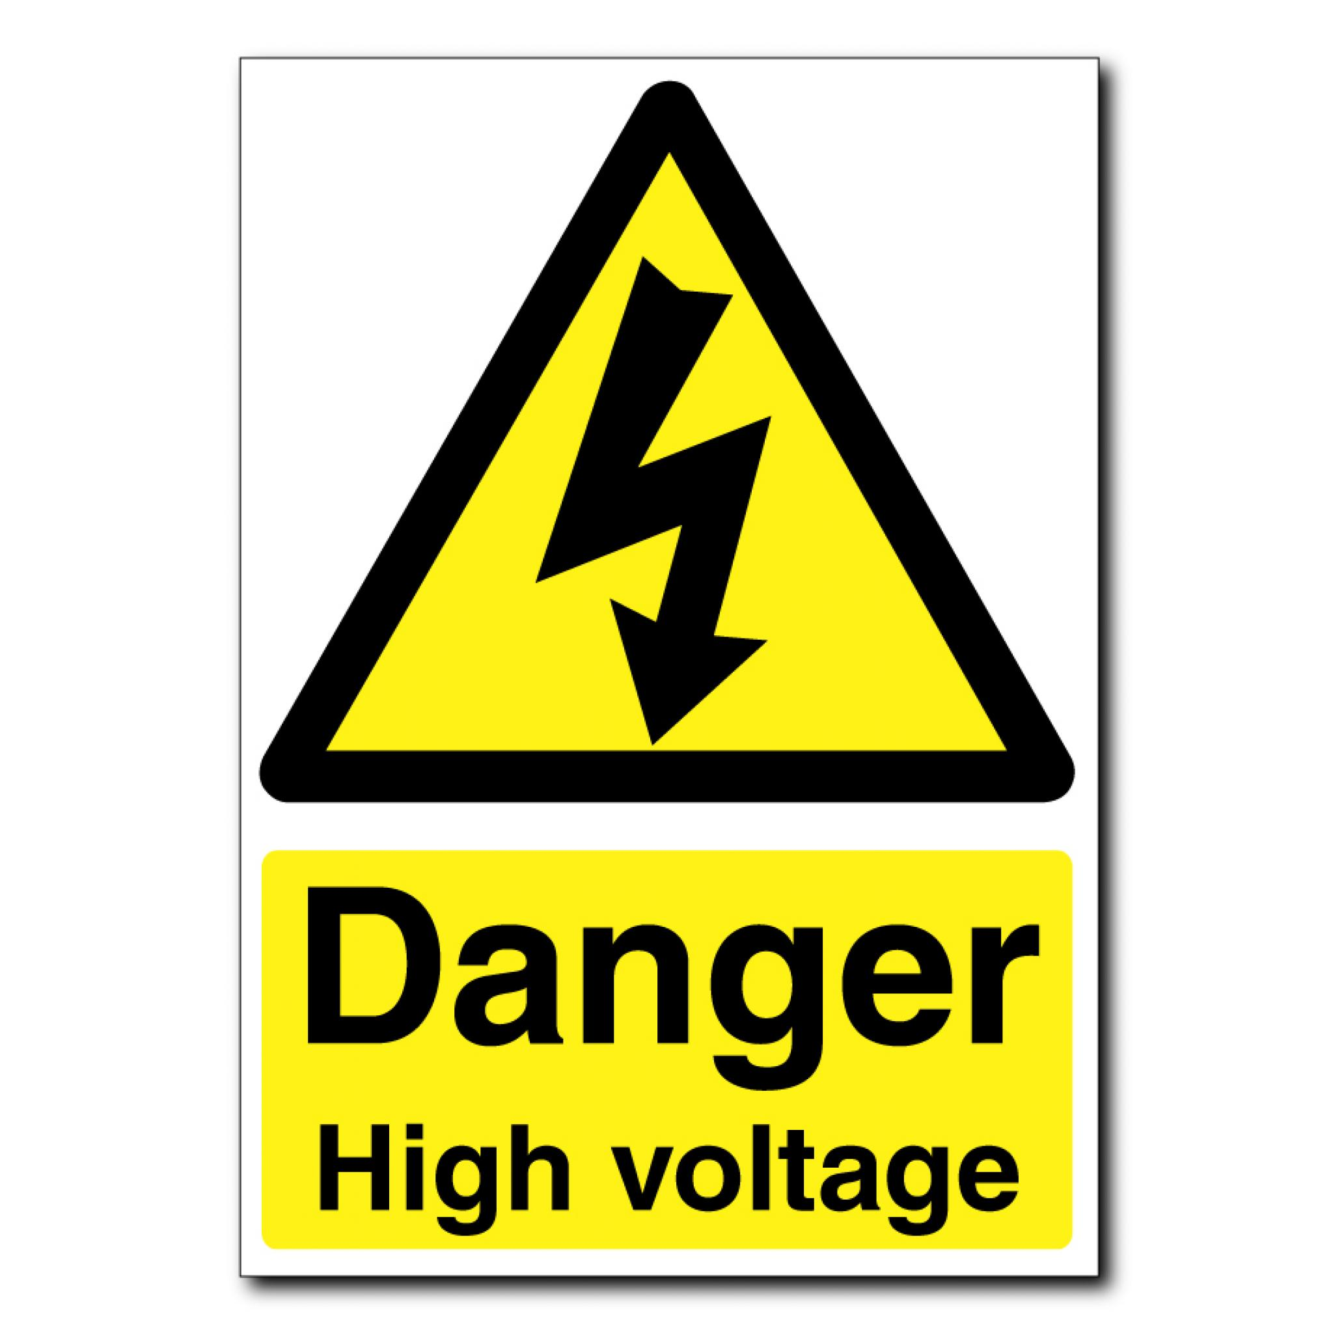
Voltage
The force that makes electricity move.
It is measured between two points, such as the positive and negative terminals of a battery.

Slide 27
Current

Slide 28
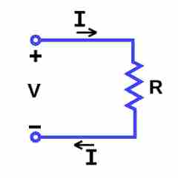
Current
The flow of electrons in a circuit.

Slide 30
bulb

Slide 31
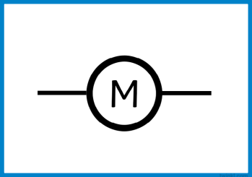

Slide 32
motor

Slide 34
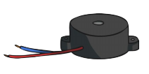
buzzer

Slide 36
bulb (lit)

Slide 37
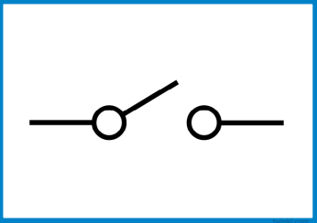

Slide 38
switch (open)

Slide 39
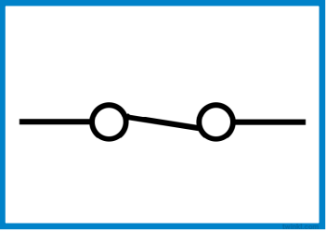

Slide 40
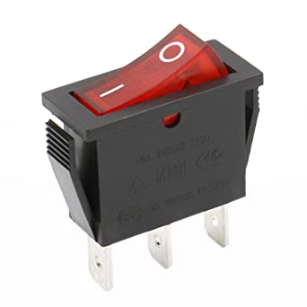
switch (closed)

Slide 41
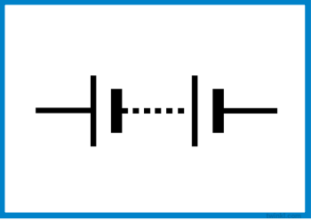

Slide 42
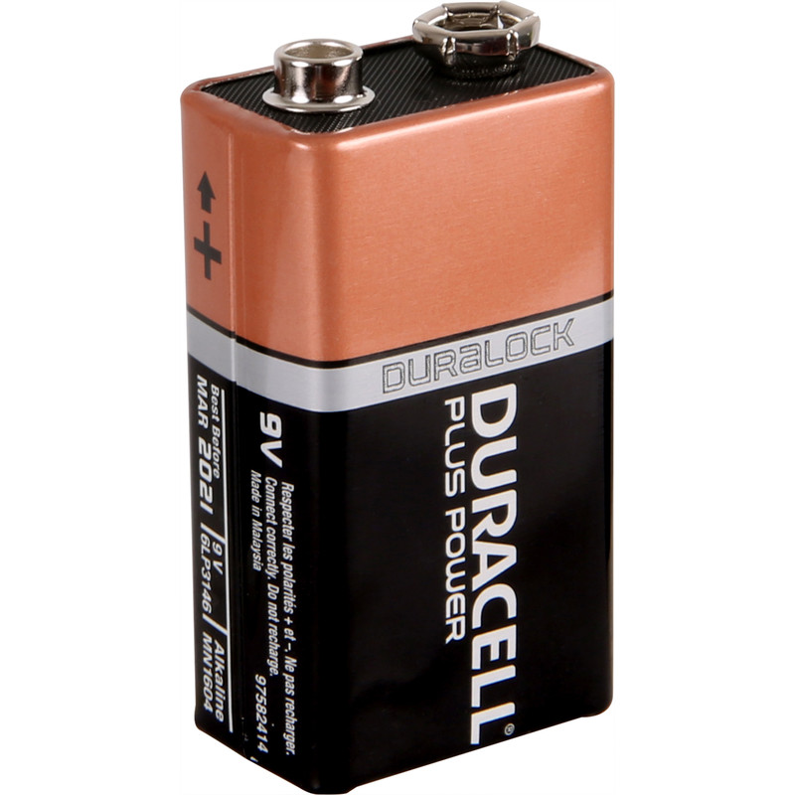
battery

Slide 43
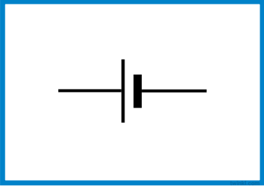

Slide 44
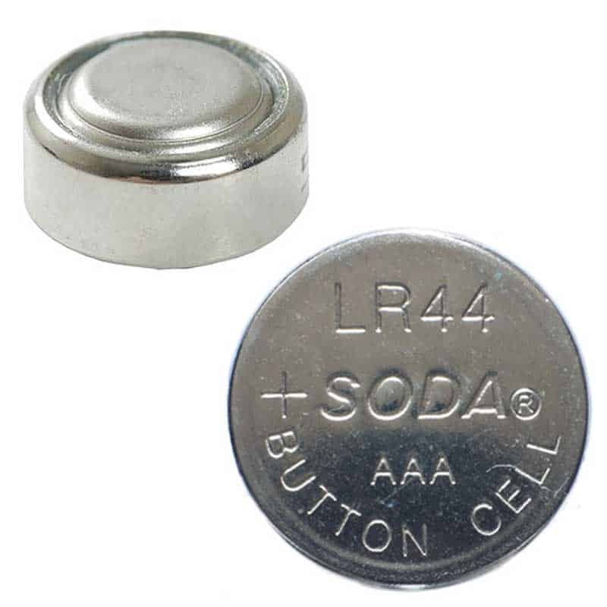
cell

