Slide 1
Forces

Slide 2
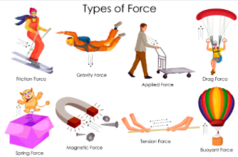
Forces
A force is any push or pull on an object.

Slide 3
Gravity

Slide 4
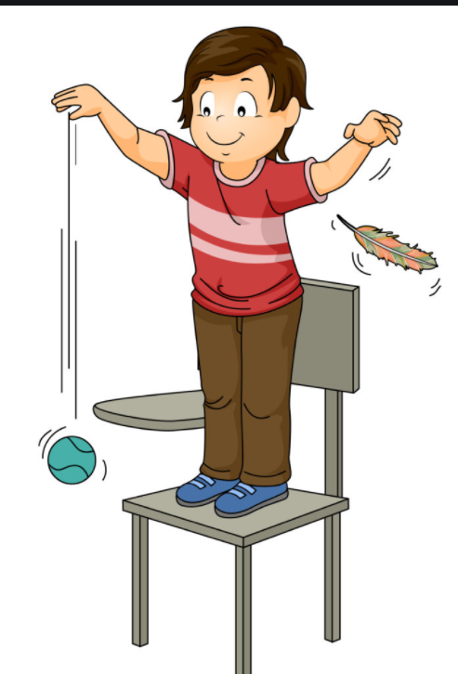
Gravity
Gravity is the name for the force that pulls everything down toward the centre of the Earth.

Slide 5
Push

Slide 6
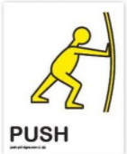
Push
The force that moves an object away from something.

Slide 7
Air resistance

Slide 8
Air resistance
Air resistance is a type of friction between air and another material.

Slide 9
Water resistance

Slide 10
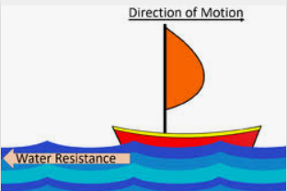
Water resistance
Water resistance is a type of force that uses friction to slow things down that are moving through water.

Slide 11
Gas

Slide 12
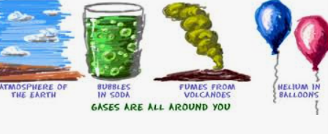
Gas
Gas is a state of matter that has no fixed shape and no fixed volume.

Slide 13
Liquid

Slide 14
Liquid
A substance that flows freely but is of constant volume

Slide 15
Counteracts

Slide 16
Act against (something) in order to reduce its force
Counteracts

Slide 17
Dense

Slide 18
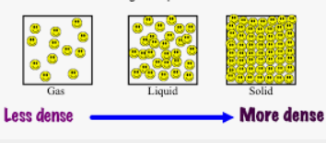
Dense
Closely compacted in substance.

Slide 19
Galileo Galilei (1564-1642)

Slide 20
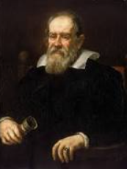
Galileo Galilei (1564-1642)
Galileo di Vincenzo Bonaiuti de' Galilei was an Italian astronomer, physicist and engineer.

Slide 21
streamline(d)

Slide 22
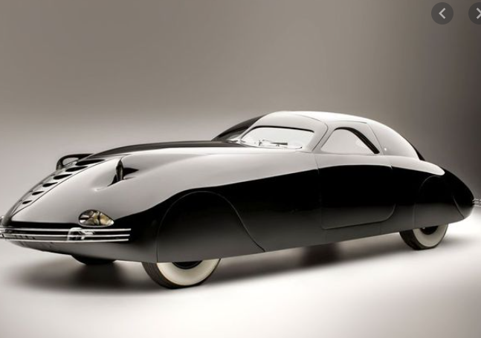
streamline(d)
Having a form that presents very little resistance to a flow of air or water.

Slide 23
Opposing forces

Slide 24
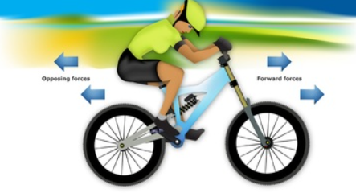
Opposing forces
Forces that work against each other

Slide 25
Efficient

Slide 26
Efficient
A comparison of the energy output to the energy input in a given system.

Slide 27
Surface area

Slide 28
Surface area
Surface area is the measure of how much exposed area a solid object has.

Slide 29
Comparison

Slide 30
Comparison
The act of examining things to see if they are similar or different

Slide 31
Reducing resistance

Slide 32
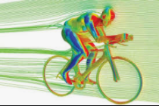
Reducing resistance
Two ways to reduce air resistance are stated: reducing the area in contact with air (by the cyclist ducking down or cycling behind someone else) and by being more streamlined (wearing smoother surfaces or a more streamlined helmet).

Slide 33
Machinery flashcards

Slide 34
Machines
Devices
fulcrum/pivot
Gears
Cogs
Direction
Wheels
Ramps
Speed
Force
Wedges
Levers
Increase
Decrease
Screws
Drive gear
Pulleys
Clockwise
anti-clockwise

